Slide 1
IBM Advanced Data Scince Capstone
Arabic Sign Language Image Classificaition

Slide 2








Use Case and Dataset
Use Case
Recognize Arabic Arm Sign Language
Train a Deep Learning Model to recognize/classify images of hand gistures into arabic sign language
Datasets
54k images of arabic sign language categoried into 32 class category
https://www.sciencedirect.com/science/article/pii/S2352340919301283
Mapping Dataset : map images file location and class
Class label Dataset : Arabic and English class label clasification

Slide 3
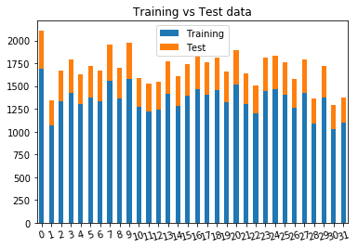
Preparing Datasets
Split Images into (Training and Validation, Test, Prediction)
Resize to 64x64, Convert to Grayscale
Convert Images to nparray
Normalize
Convert Class Label (Integer) to Binary class matrix
Prediction | 96 | (3x32)
Training/Validation | 43,150 | 80%
Training | 30,205 | 70%
Validation | 12,945 | 30%
Test | 10,803 | 20%
Shape of: | Images | Label
Training/Validation
Training | (30205, 64, 64, 1) | (30205, 32)
Validation | (12945, 64, 64, 1) | (12945, 32)
Test | (10803, 64, 64, 1) | (10803, 32)
Prediction | (96, 64, 64, 1) | -

Slide 4
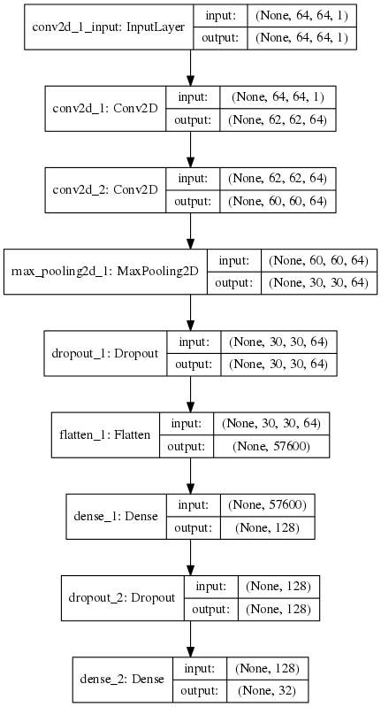
Model Definition
Keras Convolutional Neural Network (CNN)
No# of Epoch : 35 ( with EarlyStopping)
Batch Size: 10
Optimizer: Adam
Accuracy on Validation Data: 94.38%
Accuracy on Test Data: 94.32%

Slide 5
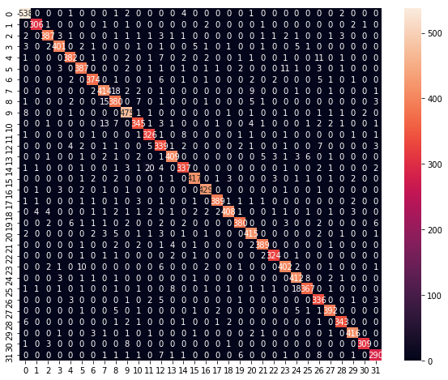
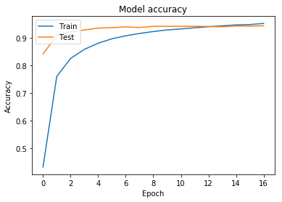
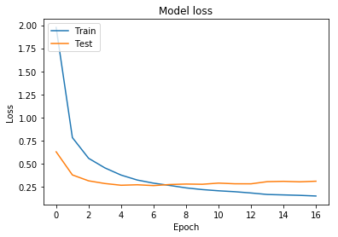
Model Training and Evaluation
Traind on 30205 samples (94.43% Accuracy)
Validate on 12945 samples (94.09% Accuracy)

Slide 6
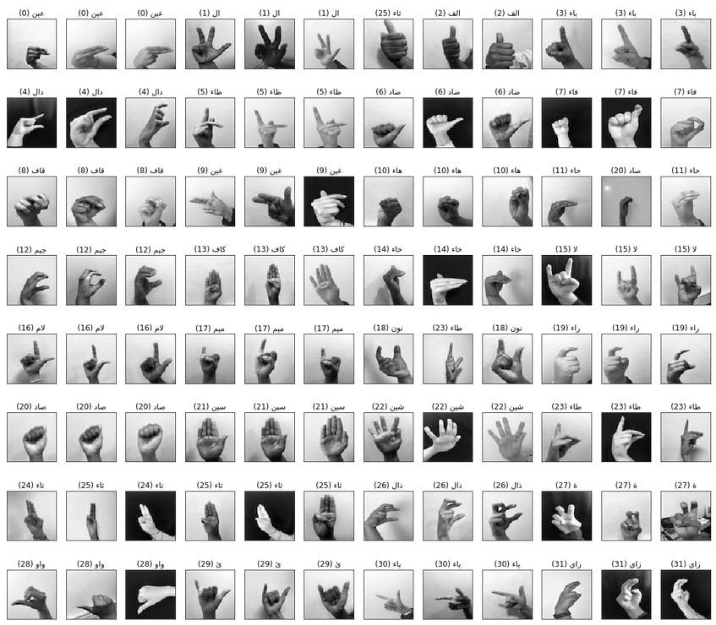
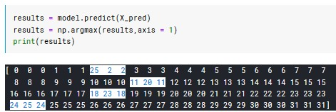
Model Prediction

Slide 7
Model Prediction (more...)

Slide 8
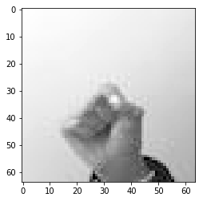
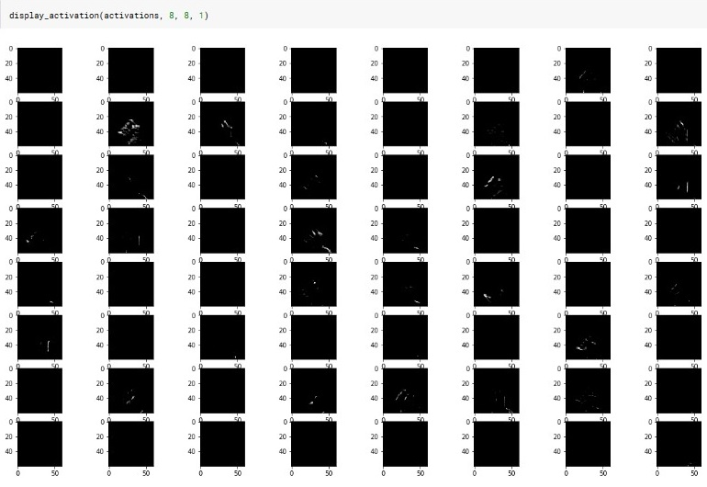
Extra: Visualize CNN Layers

Slide 9
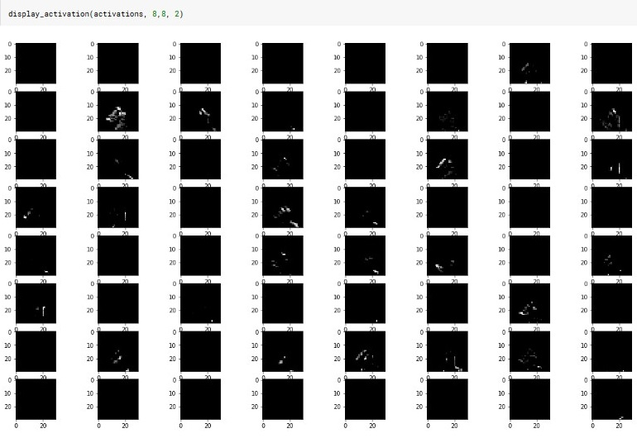
Extra: Visualize CNN Layers

Slide 10
Links
ArASL: Arabic Alphabets Sign Language Dataset (origenal source)
https://www.sciencedirect.com/science/article/pii/S2352340919301283
Arabic Arm Sign Language Image Classification Kaggle Kernal
https://www.kaggle.com/zssash/arabic-sign-language-image-classification
Arabic Arm Sign Language Image Classification Python
https://github.com/ZssAsh/ArASL
asfdasfd

Slide 11
Thank you

